Slide 1
Phase congruency for Edge Detection of touching objects
Phase II Project Presentation
Sequoia Andrade

Slide 2
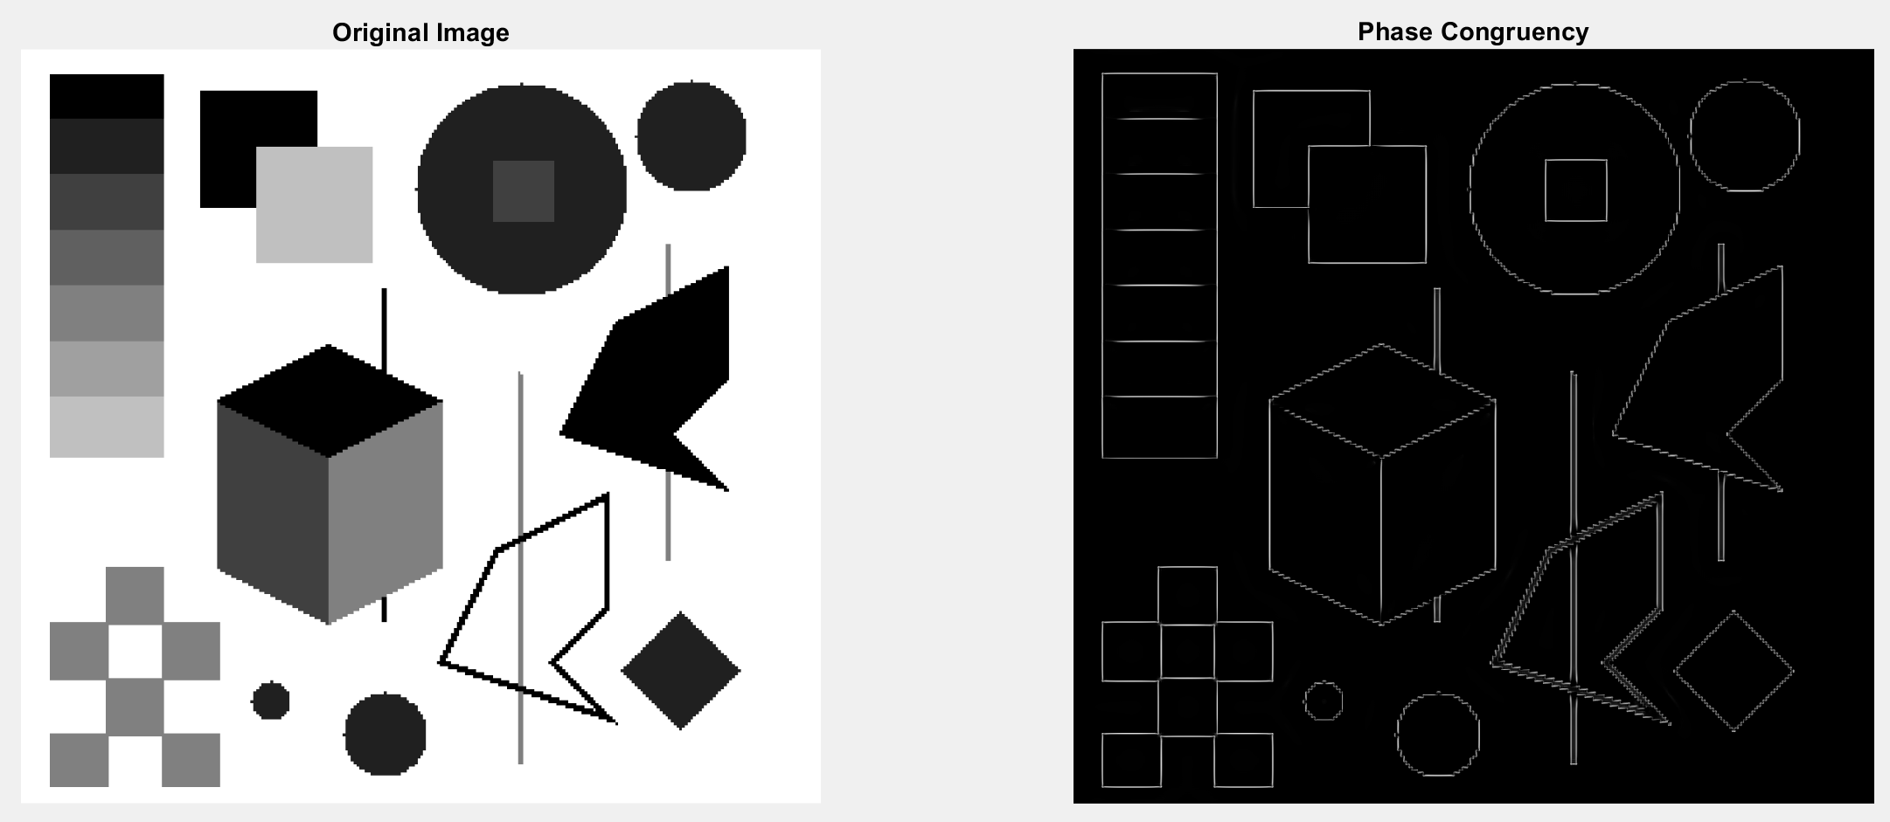
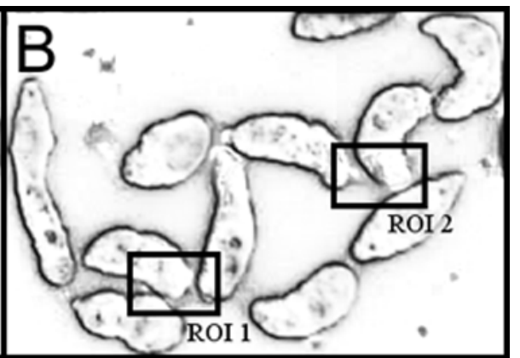
Motivation
Edge detection is a computer vision method vital for problems including object detection and pattern recognition
While phase congruency is a successful method for edge detection, it has difficulty when objects are touching
An approach to overcoming this weakness is to identify the nature of interference between the signals of two objects
[1]
[2]

Slide 3
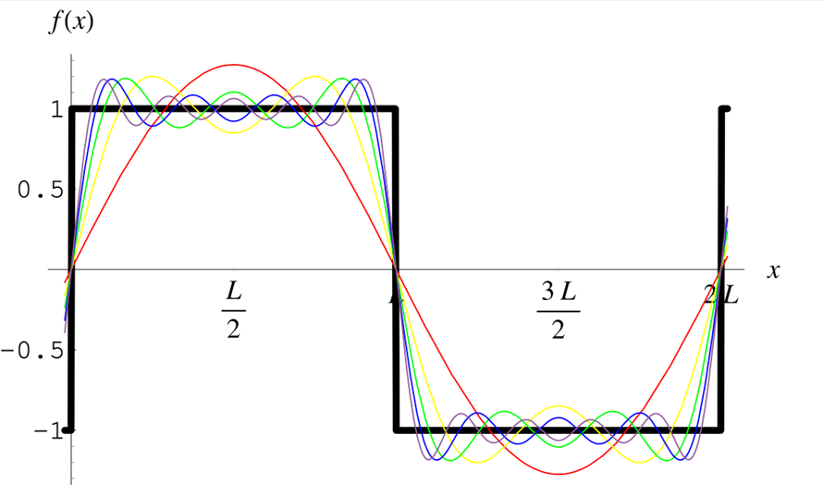
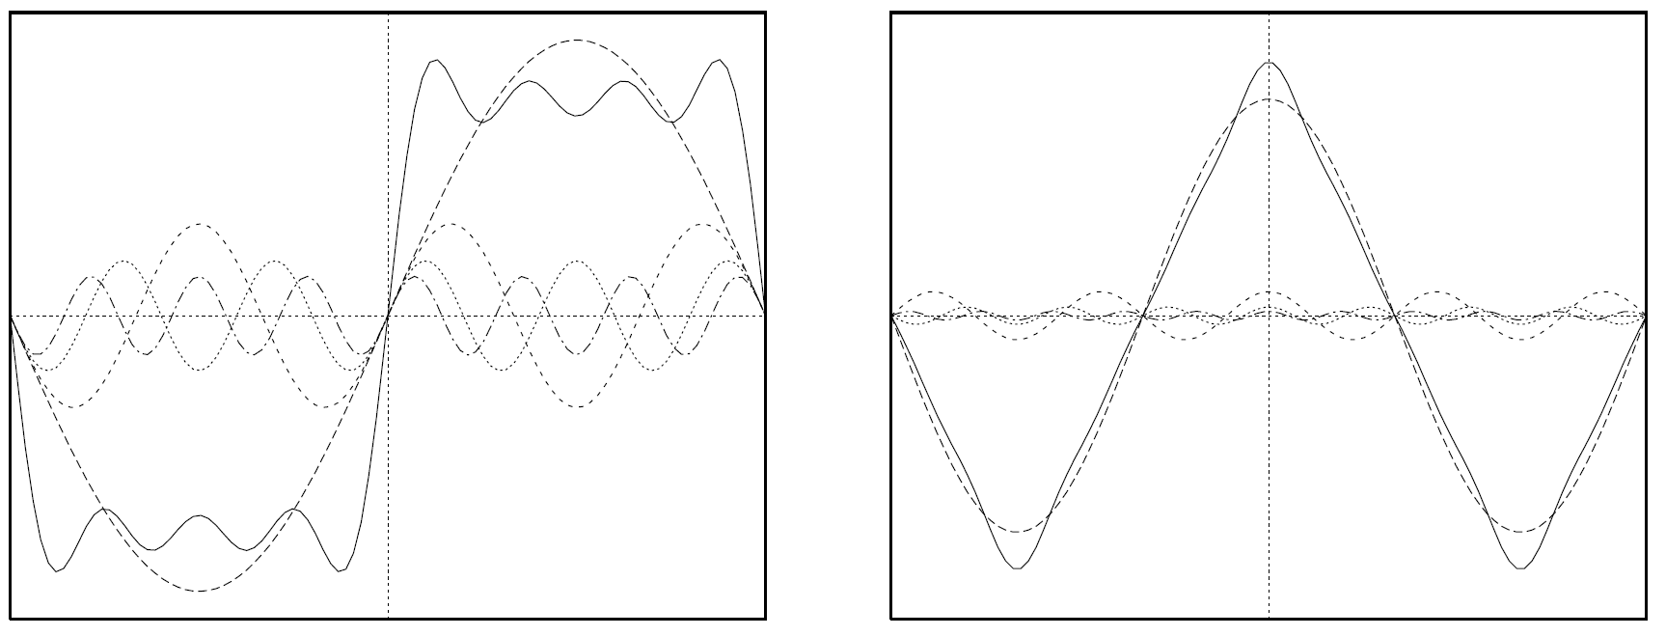
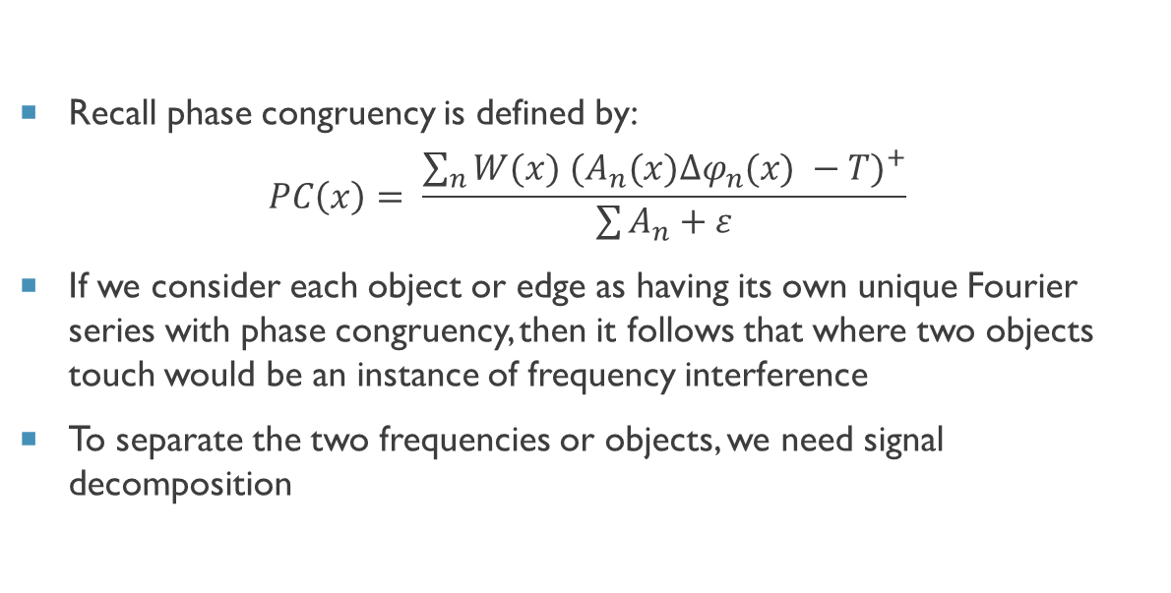
Review of Phase Congruency
[3]
Recall phase congruency is defined by:
$$PC\left(x\right)= \frac{\sum_{n}{{W(x) (A_{n}(x){∆φ}_{n}(x) −T)}^{+}}}{\sum{A_{n}}+ε}$$
If we consider each object or edge as having its own unique Fourier series with phase congruency, then it follows that where two objects touch would be an instance of frequency interference
To separate the two frequencies or objects, we need signal decomposition
[1]

Slide 4
Phase Congruency Implementation
Parameters:
Im – image
Nscale – number of filters/scales to use to calculate PC
minWaveLength – wavelength of smallest scale filter
Mult – scaling factor between successive filters
sigmaOnf – ratio of the standard deviation of the gaussian to the filter center frequency for the bank of filters
K – number of standard deviations noise energy must be above
noiseMethod – method for noise statistics (median, mode, none)
cutOff – fractional measure of frequency spread below which phase congruency values get penalized
G – controls the sharpness of the transition in the sigmoid function used to weight phase congruency for frequency spread
deviationGain – amplification to apply to the calculated phase deviation result, sharpens edges
Returns:
PC – phase congruency of the image
Or – orientation of the image
Ft – local weighted mean phase angle for every point in the image
T – calculated noise threshold
For this phase, the Mult, and deviationGain parameters are focused on, as well as the PC output

Slide 5
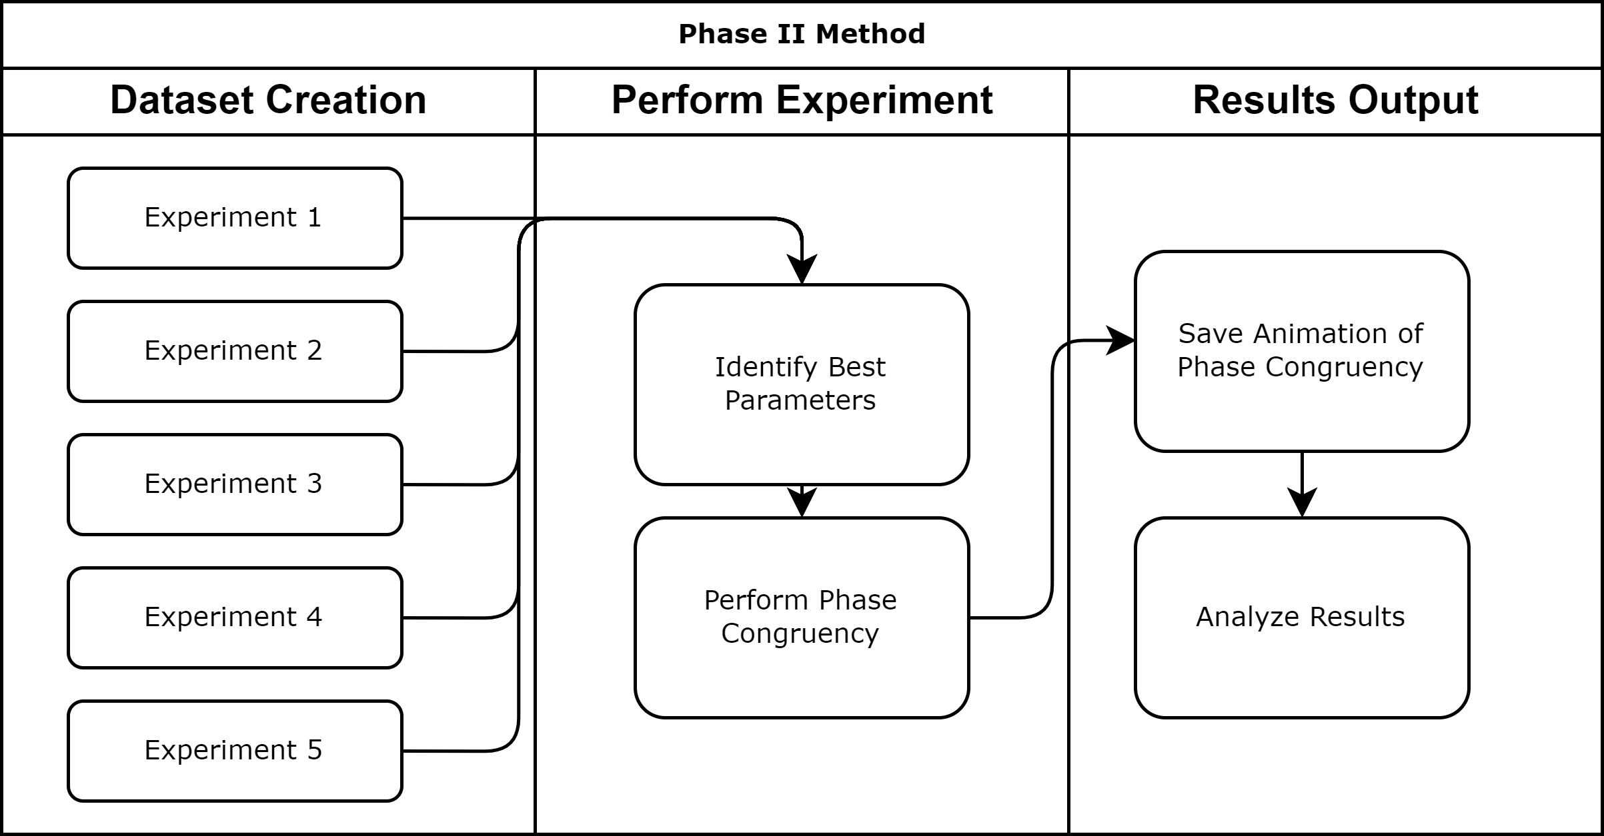
Method

Slide 6
Dataset Creation
Use idealized images to investigate changes in phase congruency
Guiding principles:
Use different edge types – line, step
Use different shapes – square, circle
Use different numbers of shapes – 2, 3
Use different distances between shapes – pre- active- and post-contact
Dataset was created using power point
Dataset consists of five experiments with six images in each experiment

Slide 7
Experimental Set-up
For each experimental dataset:
Identify the best parameters
Run phase congruency for features
Track metrics
Metrics to track:
Phase congruency for the image
Note that since we are using idealized images, noise parameters will not be important
Parameters to vary:
Mult – scaling factor between successive filters
Values: 1.5, 2.1 (default), 2.5
deviationGain – amplification to apply to the calculated phase deviation result, sharpens edges
Values: 1, 1.5 (default), 2

Slide 8
Results: Experiment 1
Line edges
Best Parameters
Mult: 1.5
deviationGain: 1.5, 1
Higher values of both parameters result in poorer edge detection in this case
Findings:
While some interference occurs, the edges are still present in all test cases for both squares

Slide 9
Results: Experiment 2
Step Edges
Best Parameters:
Mult: 1.5
deviationGain: 1
Again, high values result in worse results. Deviation gain has the greatest impact
Findings:
Both squares show degraded edge detection, but the stationary square experiences it a greater degree

Slide 10
Results: Experiment 3
One line edge, one step edge
Best Parameters:
Mult: 1.5
deviationGain: 1.5
Weird interference pattern shows up with lower numbers, but the result is better
Findings:
The step edge or solid square is most impacted by the interference
The line edge square has its edge successfully tracked

Slide 11
Results: Experiment 4
Line edges, square and circle
Best Parameters:
Mult: 1.5
deviationGain: 2
Weird interference pattern shows up again
Findings:
The edge is much less pronounced on the ellipse object
The square exhibits worse edge degradation than when touching another square

Slide 12
Results: Experiment 5
Line edges, 3 squares
Best Parameters
Mult: 1.5
deviationGain: 1
Larger values give worse results
Findings:
Edge degradation is minimal and appears to show similar patterns as with two line edge squares
Main point of interference is where overlapping edges touch

Slide 13
Discussion
Different types of idealized images show different patterns for edge degradation from interference
Step edge objects exhibited greater interference than line edges, but this may be due to the thick weighting on the lines
For all datasets, edge degradation became apparent right before actual contact
Edge degradation is most severe for the object in the background
Parameter tuning has an impact on touching edges, however there may be interference
There are many other idealized datasets that can be made (e.g., more complex shapes, roof edges, etc)
These experiments do not yet address signal decomposition

Slide 14
Future Work
Investigate the possibility of signal decomposition
Issue is that here we may need a time series of edges to determine the true signal
This will be new to me and difficult to conceptualize in a discrete domain
Explore other idealized datasets
Explore parasite dataset

Slide 15
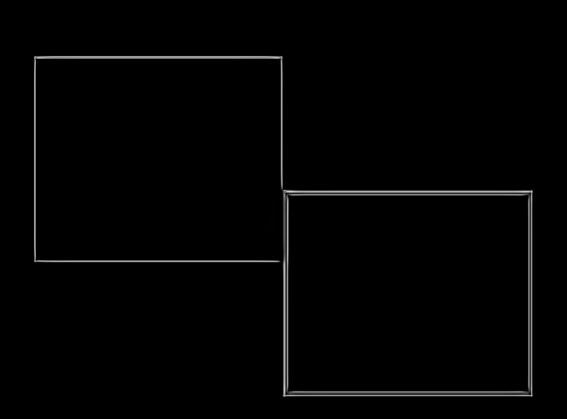
Conclusion
In phase II:
Created a dataset consisting of five experimental conditions with six object placements in each experiment
Experimental conditions varied on object shape, edge type, and number of objects
Identified best parameters for each experiment
Analyzed the impact of experimental conditions on edge degradation

Slide 16
References
[1] Kovesi, P. (1999). Image features from phase congruency. Videre: Journal of computer vision research, 1(3), 1-26.
[2] Asarnow, D.E., & Singh, R. (2013). Segmenting the Etiological Agent of Schistosomiasis for High-Content Screening. IEEE Transactions on Medical Imaging, 32, 1007-1018.
[3] Wolfram Mathworld(2022, September 30). Fourier series. Retrieved 07:35, October 17, 2022, from https://mathworld.wolfram.com/FourierSeries.html

